Slide 1
Python - Object Oriented Programming I
Session 7

Slide 2
Objectives
Introduction to OOP
OOP features in Python
Define class
Instance object

Slide 3
Procedural oriented approach
Every function is written in such a way that it can interface with other functions in the program. Data belonging to a function can be easily shared with other in the form of arguments, and called function can return its result back to calling function.
This approach seems to be sound one, but as the scope of program becomes larger and complex, it begins to show signs of strain, eventually leading to failure. Prominent problems related to procedural approach are as follows:
  The top-down approach adapted by procedure oriented languages makes the program difficult to maintain. If a change in top-level function is required, it may lead to making cascaded changes in all lower level functions.
  Procedural approach uses a lot of global data items, which is undesired. Especially in big and complex programs with large number of functions, too many global data items would increase memory overhead.
  Computer program describes procedure of data processing. However, procedural approach gives more importance to process and doesn’t consider data of same importance and takes it for granted, thereby it moves freely through the program.

Slide 4
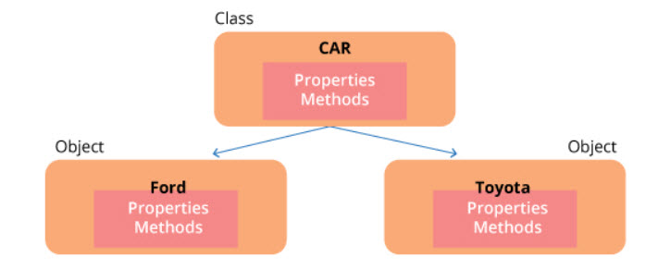
Object oriented approach
In real world we come across, deal with and process objects, such as student, employee, invoice, car etc.. Objects are not only data and not only functions, but combination of both.
Each real world object has attributes and behaviour associated with it.

Slide 5
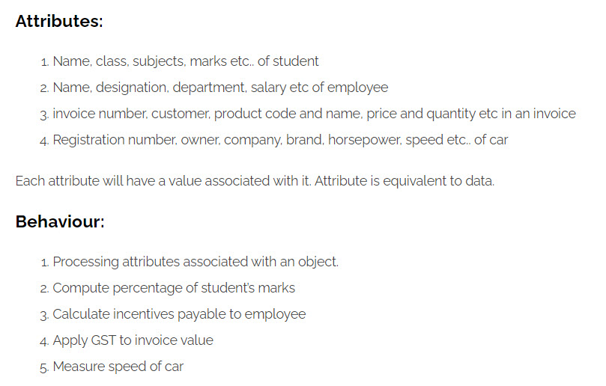
Python - Object Oriented

Slide 6
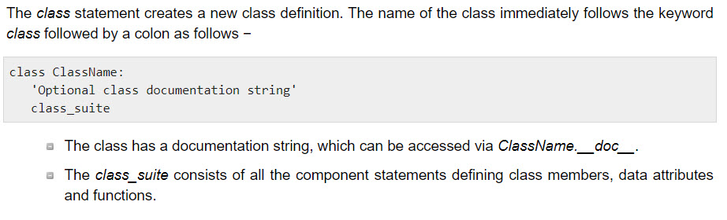
Creating Classes

Slide 7
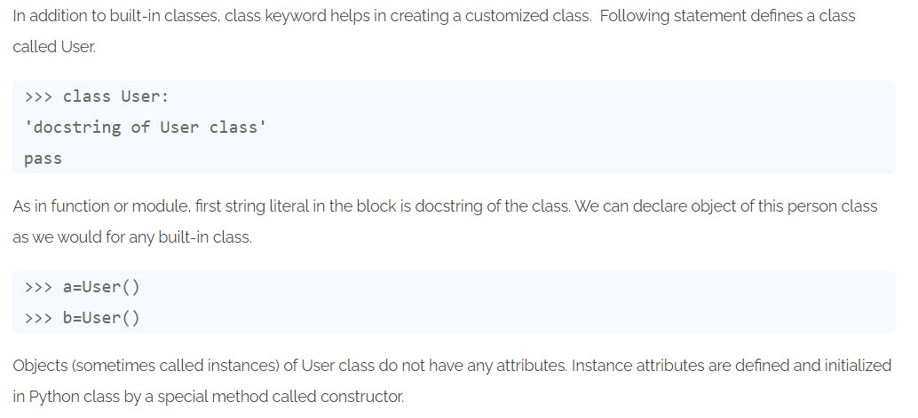
User defined Class

Slide 8
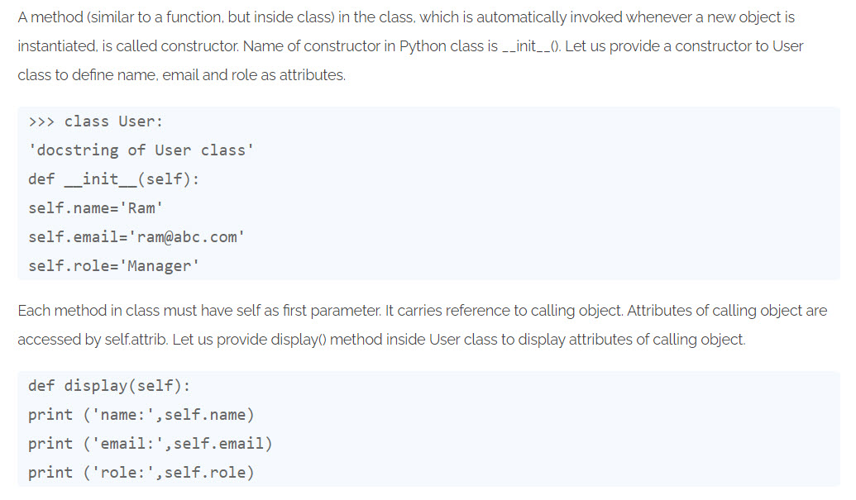
Constructor

Slide 9
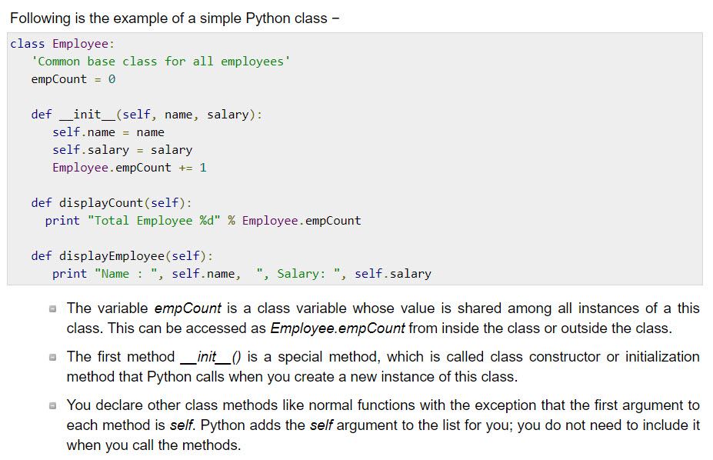
Creating Classes

Slide 10
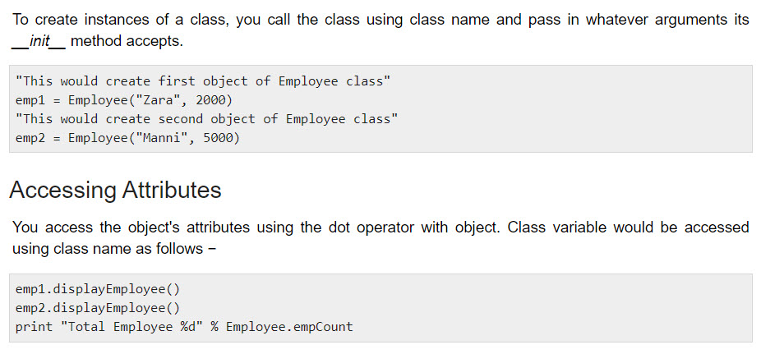
Creating Instance Objects

Slide 11
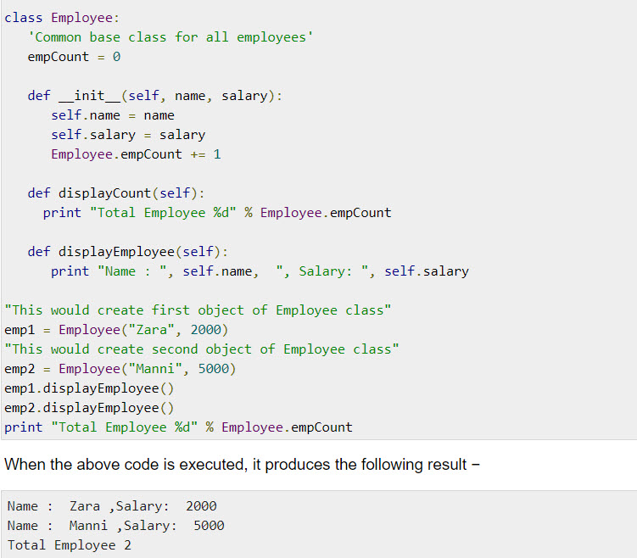
Creating Instance Objects

Slide 12
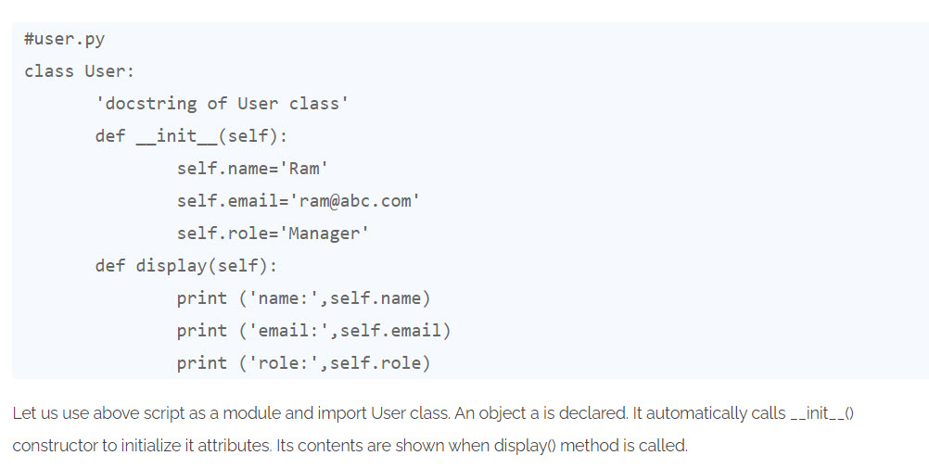
Example

Slide 13
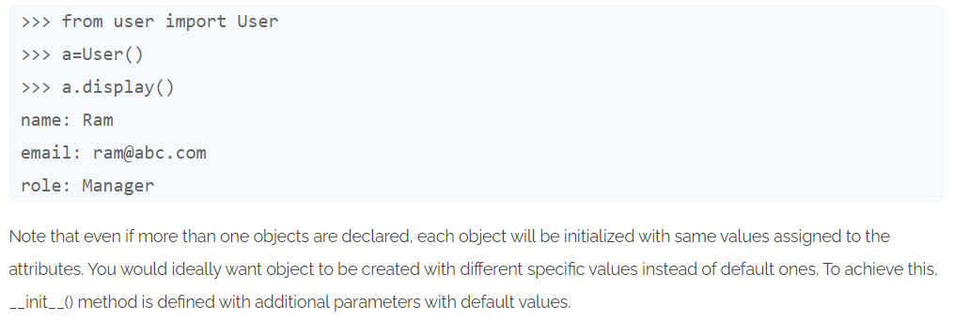
Example

Slide 14
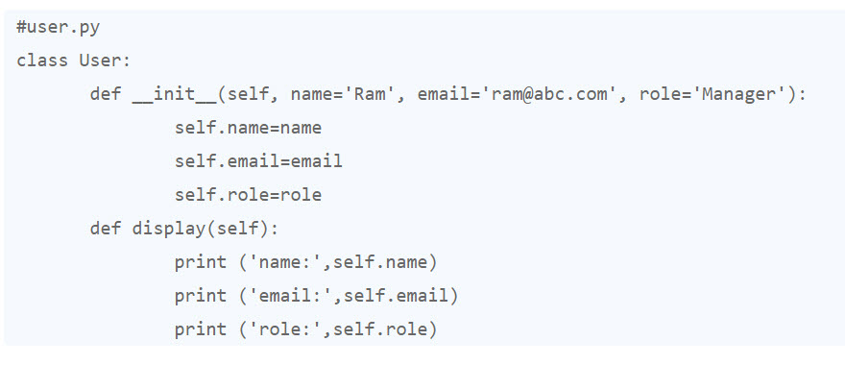
Example

Slide 15
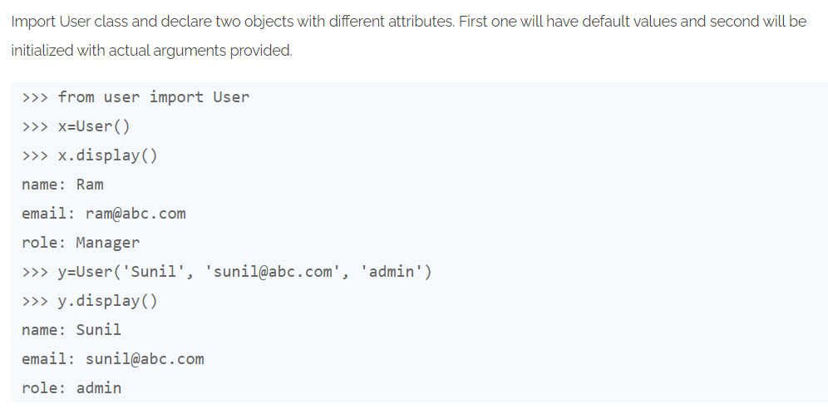
Example

Slide 16
Summary
Introduction to OOP
OOP features in Python
Define class
Instance object

